Slide 1




Deforestation Exploration Project
Group’s members:
Ayoub Azez
Alaa Elgafary
Esraa Gamal
Menna Elshamy
Mohamed Tawab
Saida Badawy

Slide 2


Agenda
Introduction
Part 1 – Global Situation
Part 2 - Regional Outlook
Part 3 - Country-Level Detail
Dashboard
Result and finding
Conclusion

Slide 3



Introduction
Deforestation poses one of the greatest challenges to global environmental sustainability. It not only threatens biodiversity but also accelerates climate change by reducing the planet's natural ability to absorb carbon dioxide. This project explores deforestation patterns and trends using SQL to analyze comprehensive datasets containing forest area, total land area, and regional affiliations.

Slide 4
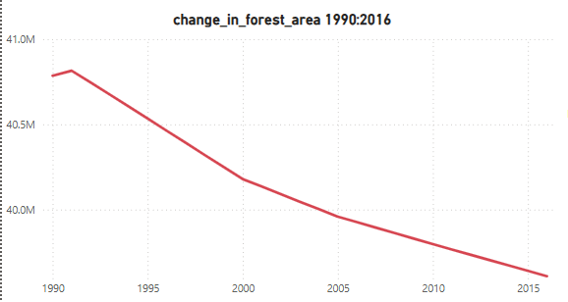
Part 1 - Global Situation
According to the dataset, the total forest area of the world was 41282694.9 km2 in 1990. As of 2016, the most recent year for which data was available, that number had fallen to 39958245.9 km2, a loss of 1324449 km2, or 3.21%.
The forest area lost over this time period is slightly more than the entire land area Peru listed for the year 2016 (which is 1280000 km2).

Slide 5
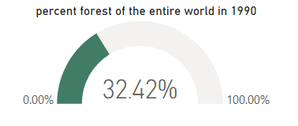
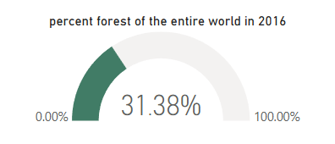
Part 2: Regional Outlook
In 1990, the percent of the total land area of the world designated as forest was 32.42% The region with the highest relative forestation was Latin America & Caribbean, with 51.03%, and the region with the lowest relative forestation was Middle East & North Africa, with 1.78% forestation.
In 2016, the percentage of the total land area of the world designated as forest was 31.38%. The region with the highest relative forestation was Latin America & Caribbean with 46.16% and the region with the lowest relative forestation was Middle East & North Africa with 2.07% forestation.

Slide 6
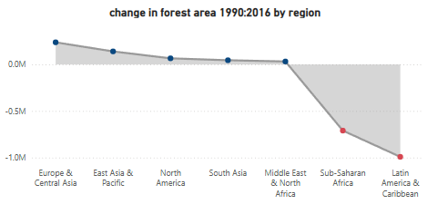
Part 2: Regional Outlook
The only regions of the world that decreased in percent forest area from 1990 to 2016 were Sub-Saharan Africa (dropped from 30.67% to 28.79%) and Latin America & Caribbean (51.03% to 46.16%). All other regions actually increased in forest area over this time period. However, the drop in forest area in the two aforementioned regions was so large, the percent forest area of the world decreased over this time period from 32.42% to 31.38%.

Slide 7
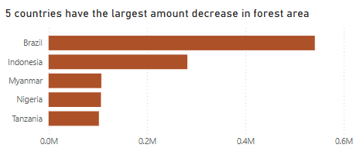
Part 3 - Country-Level Detail
Which countries are seeing deforestation to the largest degree? We can answer this question in two ways. First, we can look at the absolute square kilometer decrease in forest area from 1990 to 2016. The following 5 countries had the largest decrease in forest area over the time period under consideration: Brazil, Indonesia, Myanmar, Nigeria and Tanzania

Slide 8
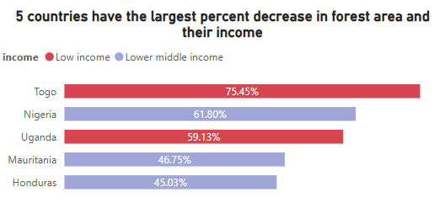
Part 3 - Country-Level Detail
The second way to consider which countries are of concern is to analyze the data by percent decrease. Top 5 Percent Decrease in Forest Area by Country, 1990 & 2016: Togo, Nigeria, Uganda, Mauritania and Honduras
From the above analysis, we see that Nigeria is the only country that ranks in the top 5 both in terms of absolute square kilometer decrease in forest as well as percent decrease in forest area from 1990 to 2016. Therefore, this country has a significant opportunity ahead to stop the decline and hopefully spearhead remedial efforts.

Slide 9
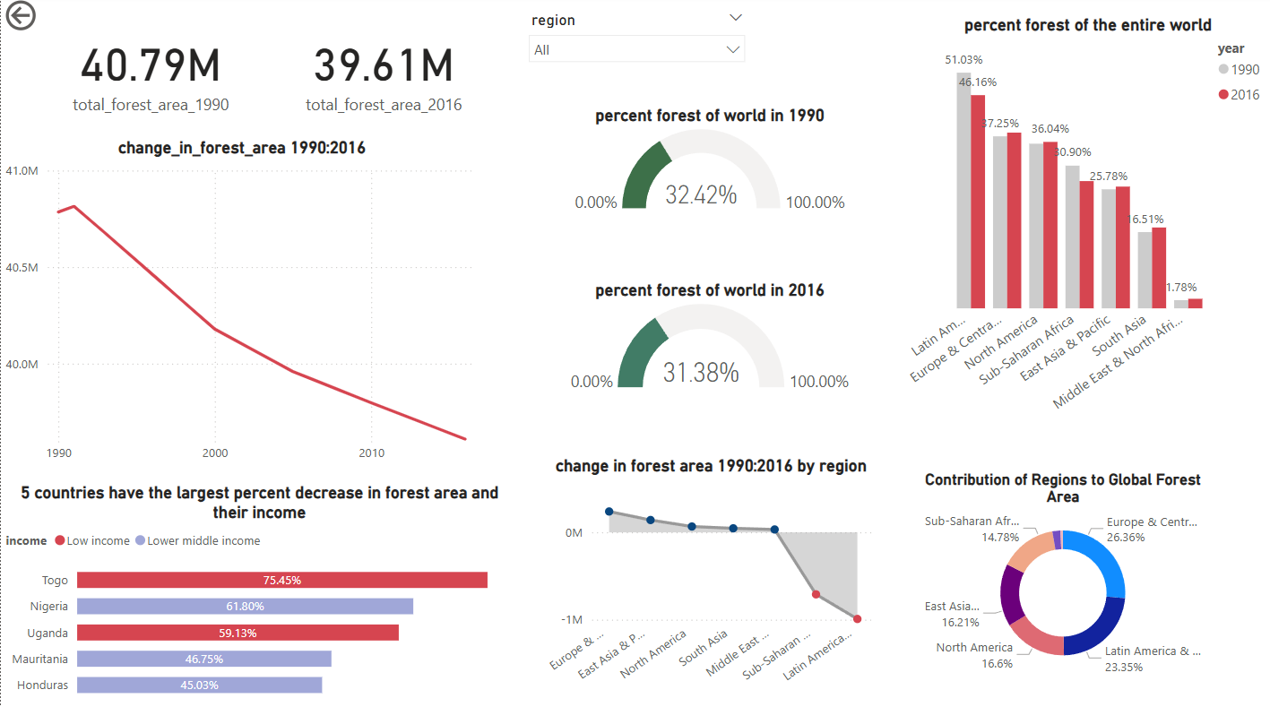
Dashboard

Slide 10
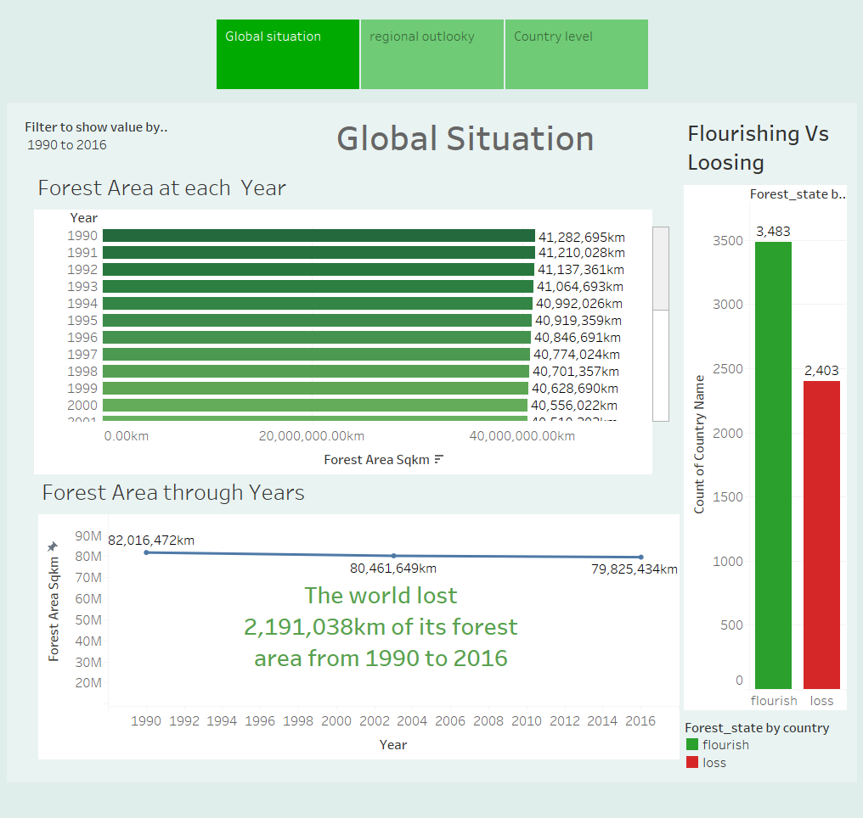

Slide 11
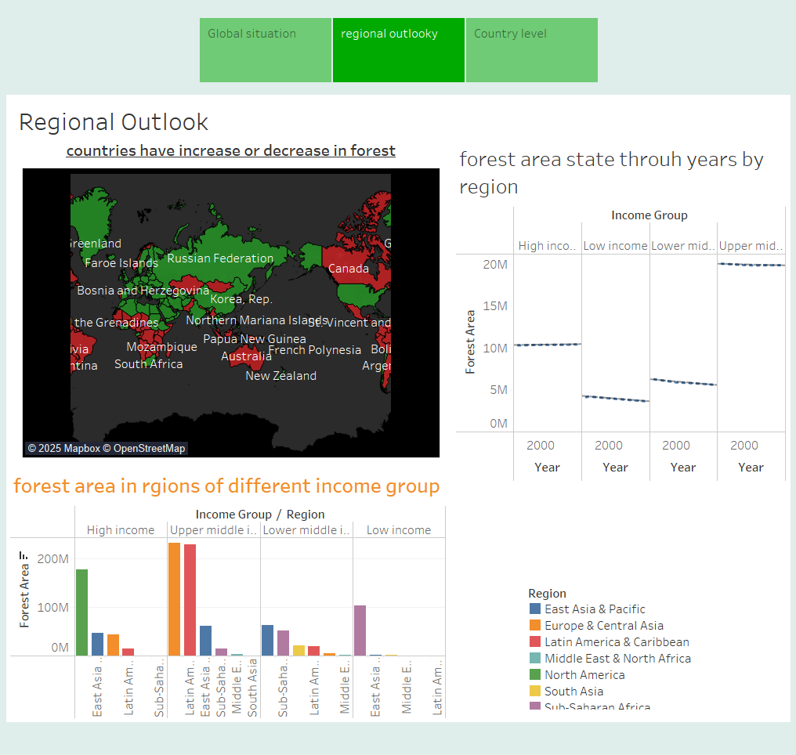

Slide 12
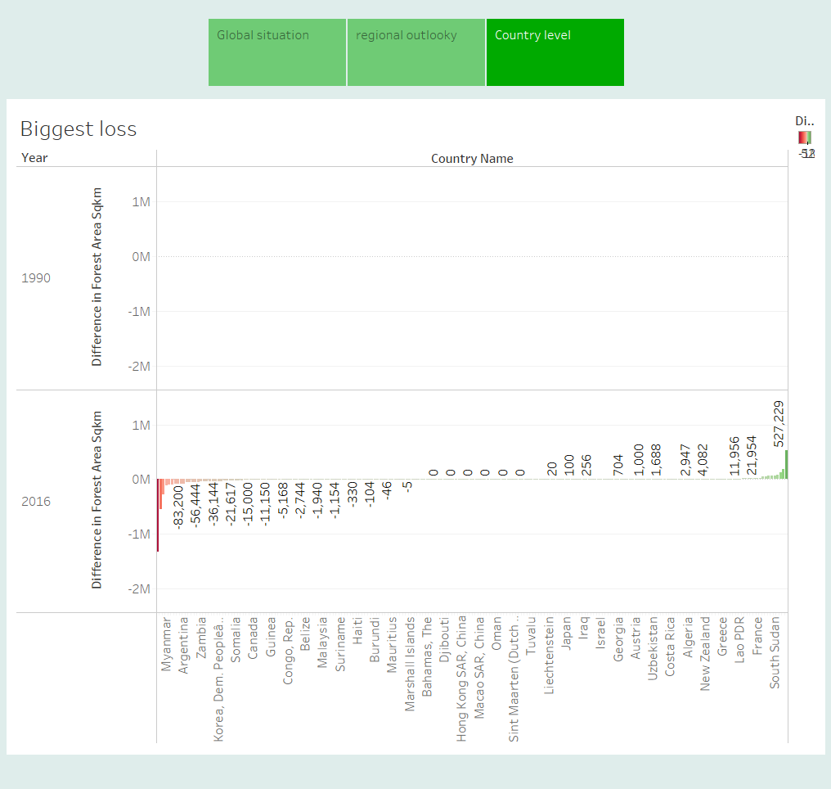

Slide 13
Results and Findings
Significant deforestation observed in developing regions.
High-income countries show stable or increasing forest cover.
Correlation between economic development and deforestation rates.

Slide 14
Conclusion
The analysis reveals that economic and regional factors play a crucial role in deforestation trends. Effective policies targeting sustainable land use are essential for reversing deforestation impacts.

Slide 15


THANK YOU!
"Forest conservation is not only an environmental task, but also the responsibility of our future generations."

